Slide 1
Requirements Management
SEG3101 (Fall 2009)

Slide 2
Contents
Introduction to Requirements Management
Traceability
Baselines
Change Management
Requirements Management Tools
A factor present in every successful project and absent in every unsuccessful project is sufficient attention to requirements.

Slide 3
Why Do Requirements Change?
Change in software development: as inevitable as difficult to control!
  Better understanding: new requirements become apparent
  Everything else is changing…
    Business
    Context
    Technologies
    Markets
    …
Possible responses to change
  Add, modify, or remove requirements

Slide 4
Some Problems Due to Changing Requirements
Requirements changing towards the end of development without any impact assessment
Unmatched/outdated requirements specifications causing confusion and unnecessary rework
Time spent coding, writing test cases or documentation for requirements that no longer exist

Slide 5
Requirements Management
A systematic approach to eliciting, organizing, and documenting the requirement of the system, and a process that establishes and maintains agreement between the customer and the project team on the changing requirements of the system.

Slide 6
Requirements Management Activities (1)
Requirements management includes all activities intended to maintain the integrity and accuracy of expected requirements
Manage changes to agreed requirements
Manage changes to baseline (increments)
Keep project plans synchronized with requirements
Control versions of individual requirements and versions of requirements documents
Manage relationships between requirements
Managing the dependencies between the requirements document and other documents produced in the systems engineering process
Track requirements status

Slide 7
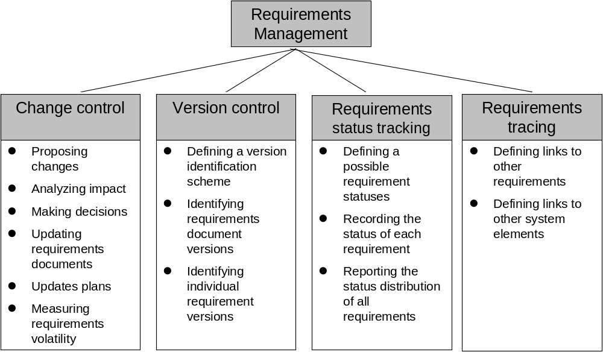
Requirements Management Activities (2)
Source: Wiegers, 1999

Slide 8
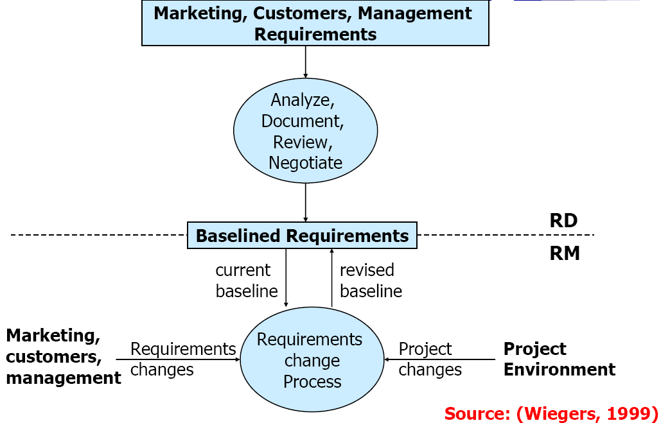
Requirements Development (RD) and Management (RM)
Source: Wiegers, 1999

Slide 9
From Management to Tools
Changes lead to a need for management
There is no management without:
  Traceability
  Baselines enabling comparisons
From a practical point of view, there is no traceability or management without appropriate tools
In theory, practice and theory are similar…
But in practice they are different ☺

Slide 10
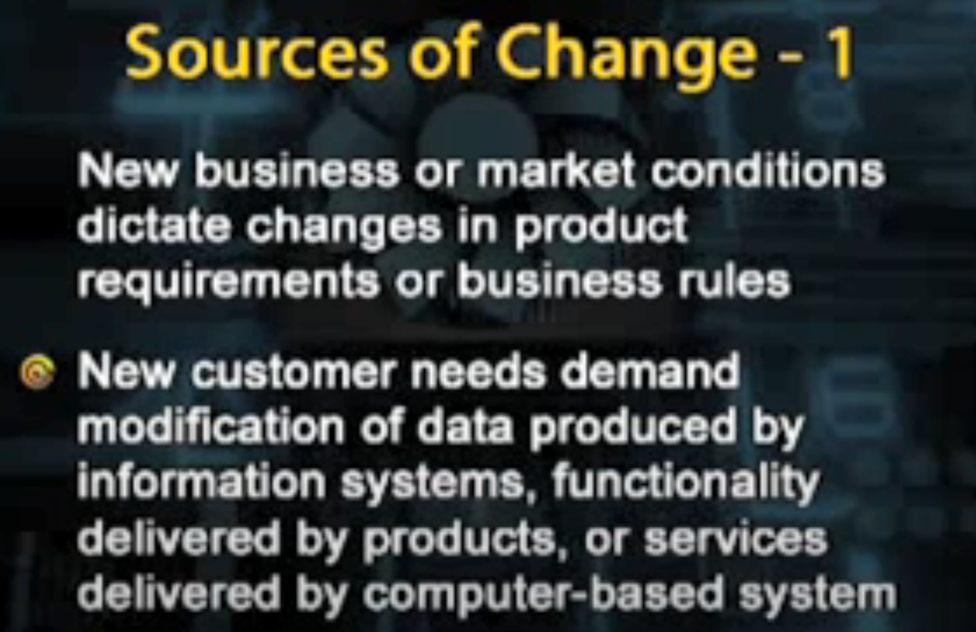

Slide 11
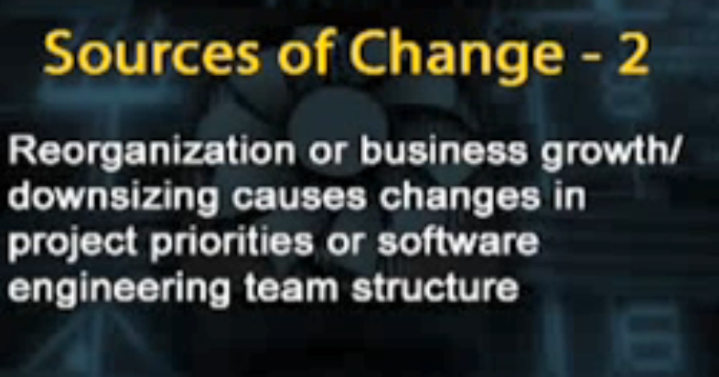

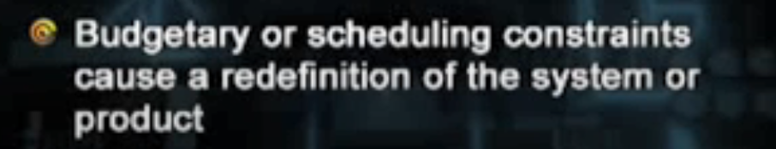

Slide 12
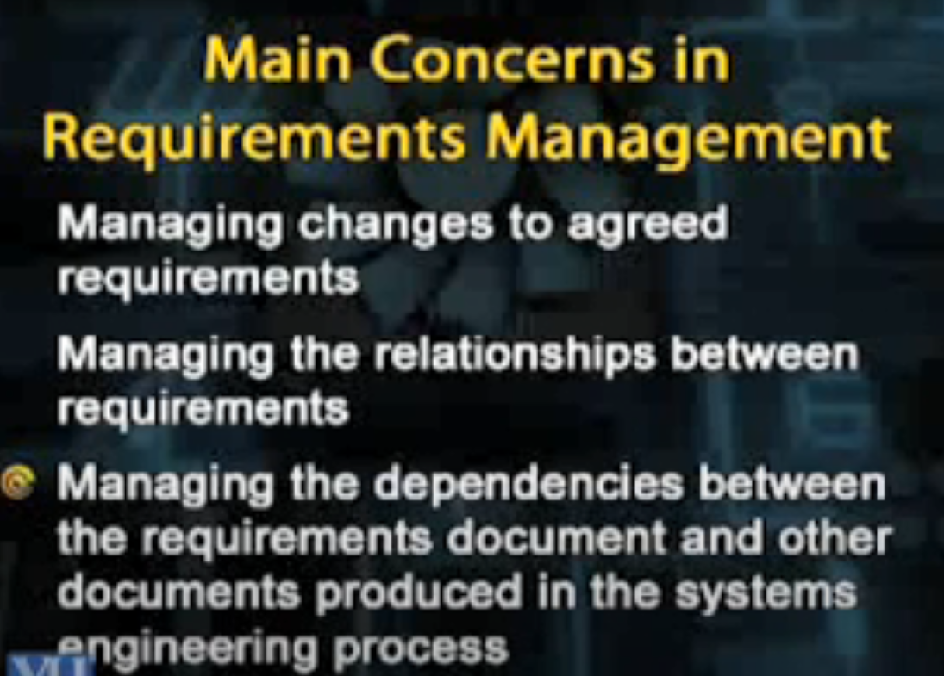

Slide 13
Stable and Volatile requirements

Slide 14
Requirements Volatility
Requirements continuously change
While the requirements are being elicited, analyzed, specified, and validated and after the system has gone into service
Some requirements are usually more subject to change than others
Stable requirements are concerned with the essence of a system and its application domain
  Derived from the client’s principal business activities or the domain model
  They change more slowly than volatile requirements
  E.g., a hospital will always have doctors, nurses, patients…
Volatile requirements are specific to the instantiation of the system in a particular environment for a particular customer at a particular time
  E.g., in a hospital, we can think of requirements related to the policies of the government health system

Slide 15
Requirements Change Factors (1)
Requirements errors, conflicts, and inconsistencies
  May be detected at any phase (when requirements are analyzed, specified, validated, or implemented)
Evolving customer/user knowledge of the system
  When the requirements are developed, customers/users simultaneously develop a better understanding of what they really need
Technical, schedule, or cost problems
  Difficult to plan and know everything in advance
  We may have to revisit the list of requirements and adapt it to the current situation

Slide 16
Requirements Change Factors (2)
Changing customer priorities, new needs
May be caused by a change in the system environment (technological, business, political...), i.e., the context
Business and strategic goals may change
May be caused by the arrival of a new competitor
Laws and regulations may change
Collaborating systems may change
May also be caused by technology changes in the enterprise (migration to a new operating system, DBMS…)
May be caused by organizational changes (organizational structure, business processes, employees…)

Slide 17
Types of Volatile Requirements
Mutable requirements
  These are requirements which change because of changes to the environment in which the system is operating
Emergent requirements
  These are requirements which cannot be completely defined when the system is specified but which emerge as the system is designed and implemented
Consequential requirements
  These are requirements which are based on assumptions about how the system will be used
  Once the system is in place, some of these assumptions will be wrong
Compatibility requirements
  These are requirements which depend on other equipment, technology, or processes

Slide 18
Identification of Requirements
It is essential for requirements management that every requirement has a unique identification
  The most common approach is requirements numbering based on chapter/section in the requirements document
There are several problems with this approach
  Numbers cannot be unambiguously assigned until the document is complete
  Assigning chapter/section numbers is an implicit classification of the requirements ➔ may mislead readers of the document into thinking that the most important relationships are with requirements in the same section

Slide 19
Requirements Identification Techniques
Dynamic renumbering
  Some word processing systems allow for automatic renumbering of paragraphs and the inclusion of cross references
  As you reorganise your document and add new requirements, the system keeps track of the cross references and automatically renumbers your requirements depending on its chapter, section, and position within the section
Database record identification
  When a requirement is identified, it is entered in a requirements database and a database record identifier is assigned which is then used for all subsequent references to the requirement
Symbolic identification
  Requirements can be identified by giving them a symbolic name which is associated with the requirement itself (e.g., SEC1, SEC2, SEC3… may be used for requirements which relate to system security)

Slide 20
Expectations of Requirements Management (1)
Identification of individual requirements
Traceability from highest level requirements to implementation
  Established via links through a requirements database
  Links between requirements and design models, tests, code…
  Coverage and consistency analysis
  What are the traceability policies? What types of links? From where? To where?
Impact assessments of proposed changes
  Analysis tools let you see which other requirements (and other linked artifacts) will be affected by a change

Slide 21
Expectations of Requirements Management (2)
Controlled access to current project information
  A shared database ensures that all users are working with current data (consistency, parallel access)
  A central repository allows all users to see the information that they need to see (visibility)
Change control
  Change proposal system implements controlled process for managing change
  How do we collect, document, and address changes?
Deployment of required tool support
  To help manage requirements change

Slide 22
Requirements Have Attributes!
Apart from an identifier, requirements should have attributes that establish context and background, and go beyond the requirement description
For filtering, analysis, metrics…
  Creation date, Last update, Author, Stakeholders (Owners / Source)
  Version number
  Status, Priority, Importance, Stability
  Rationale, Comments
  Acceptance criteria
  Subsystem / Product release number
  …
The more complex the project, the richer the attributes…
Many attributes are predefined in RM tools, others are defined by requirements engineers as required by the project

Slide 23
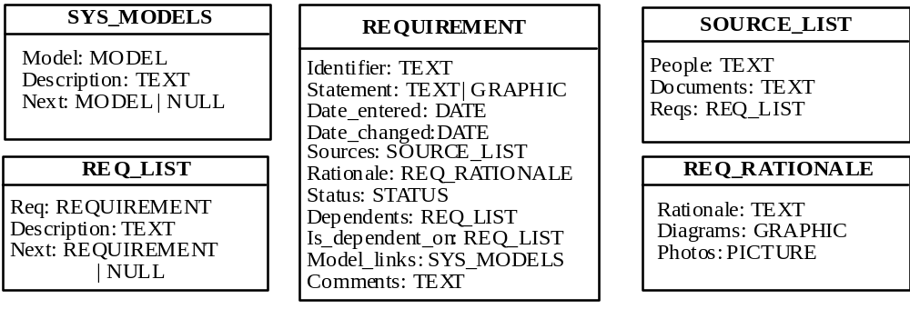
Requirements Attributes
Classes and attributes of a requirements management database
Select only the necessary attributes!

Slide 24
Requirements Status
Help manage the requirement lifecycle
  Their number and nature depend on the process in place
Example of a set of statuses:
  Proposed: by some stakeholder
  Approved: part of baseline, committed to implement
  Rejected: after evaluation
  Implemented: designed and implemented
  Verified: Relevant tests have passed
  Deleted: Removed from list
RM includes amongst its tasks the tracking of the status of all requirements during the project

Slide 25
Version Control
Another essential aspect of requirements management
  Every version of a requirement needs to be uniquely identified
  The last version of a requirement must be available to all team members
  Changes need to be documented and clearly communicated
  A version identifier must be updated with every change to the requirement
Requirements documents should include
  A revision history: changes, dates, by whom, why...
  Standard markers for revisions (e.g., strikethrough or underlined text, coloring, line markers…)
Version control tool may be used
  To store and manage the revision history
  To store justifications (to add, modify, delete, reject a requirement)

